Slide 1
COP-RCORP Consortium Meeting
April 27, 2021
1:00-2:30pm

Slide 2
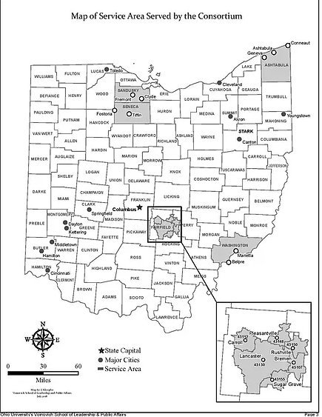
Roll Call and Attendance
Ashtabula
Fairfield
Sandusky
Seneca
Ohio University
PIRE
Notes:
Matt

Slide 3
What are you noticing in your environment that relates to the COP-RCORP Initiative?

Slide 4
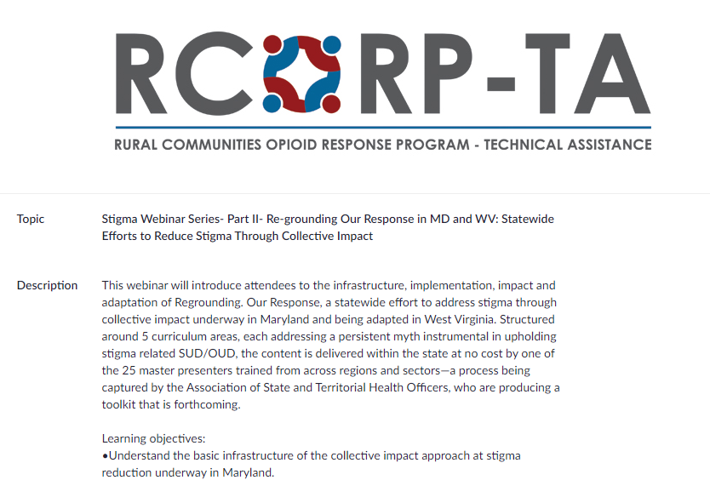
Regrounding Our Response

Slide 5
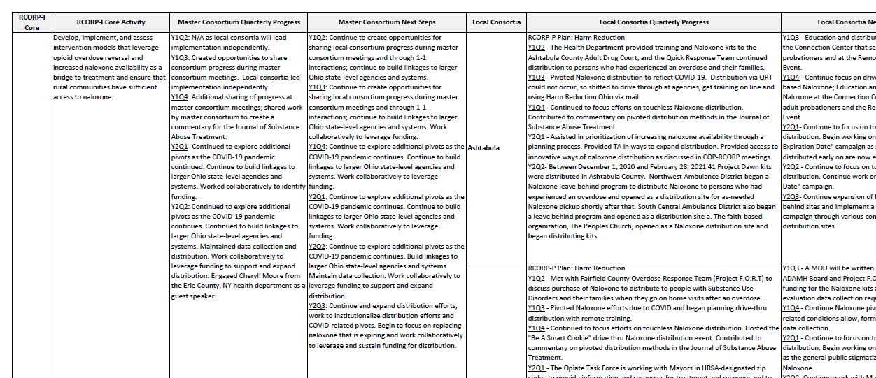
COP-RCORP Initiative Workplan

Slide 6
Workplan: Discussion & Sharing
What area/areas of work by your local consortium would you like to share with the Consortium?
Looking at the work completed by your fellow COP-RCORP members, what is one thing you are curious about?

Slide 7
Discussion: Meeting Frequency & Topics
How often should we meet as a Master Consortium?
How should we structure our Master Consortium meetings?
How can we use the meetings as a space to collaborate?
What topics would you like to cover or discuss at the next meeting?

Slide 8
Wrap Up, Support Needs, and Next Steps
Next Master Consortium Meeting:
May 25, 2021
1:00-2:30pm

