Slide 1
SERVING ALCOHOL AT AN EVENT?
?
HOW TO CONSIDER THOSE WHO DO NOT DRINK ALCOHOL

Slide 2
RECOVERY STATS
NATIONAL
For adults 18 or older,
21 million people
(6.4% of the population)
consider themselves to be in recovery from an alcohol and/or drug problem.
National Survey on Drug Use and Health (NSDH), 2020.
OHIO
For Ohioans ages 12 and over,
739,000 people
(7.5% of the population)
consider themselves to be in recovery from an alcohol and/or drug problem.
Source: Substance Abuse and Mental
Health Services Administration (SAMHSA)’s restricted online data analysis system (RDAS)
Survey: National Survey on Drug Use and Health: 2-year RDAS (2018 to 2019)
Notes:
Presentation tips
National data was taken from the 2020 National Survey on Drug Use and Health (NSDUH).
Ohio data was taken from the Substance Abuse and Mental Health Services Administration (SAMHSA)’s 2-year restricted online data system (RDAS) in 2018-2019.

Slide 3
REASONS WHY SOMEONE MAY NOT DRINK ALCOHOL
They may be in recovery from a substance use disorder.
They may be supporting someone in recovery.
They may have medical conditions that interact dangerously with alcohol.
They may be pregnant.
They may be trying to get pregnant.
They may be an adult under 21.
They may have religious reasons to abstain.
They may have alcohol allergies or intolerances.
They may simply choose not to.
They may be in a culture that prohibits alcohol.
They may be undergoing chemotherapy.
They may be on a diet.
They may have a diagnosed mental health condition.
They may be immunosuppressed.
They may be bound to sobriety by their employer.
Notes:
These are just a few reasons we could gather; there may be many more. The underlining point is that each person who chooses not to drink has their reasons.

Slide 4
To ensure your event has the most reach possible, consider having these measures:

Slide 5
Partner with the recovery community to offer recovery spaces.
To ensure your event has the most reach possible, consider having these measures:
Focus on the content of your event, have alcohol as the compliment.
Create invitations or flyers that clearly state non-alcoholic beverages will be available.

Slide 6
Partner with the recovery community to offer recovery spaces.
To ensure your event has the most reach possible, consider having these measures:
Mark the space with yellow balloons or use a yellow pop-up tent – a growing symbol for recovery safe spaces.
If applicable, the space ideally should be close to the first aid area.
Offer this space away from where alcohol is being served.
Notes:
For more information about the yellow balloons, scan the QR code at the end of the presentation.

Slide 7
Create invitations or flyers that clearly state non-alcoholic beverages will be available.
To ensure your event has the most reach possible, consider having these measures:
Great for serving the entire guest list
Cutting the alcohol saves money and calories
Can utilize fresh, organic ingredients instead of drink mixers full of preservatives and corn syrup
Avoid: Using the term “mocktail” or presenting beverages because it could be harmful to those in recovery.
Offer tasty, healthy, non-alcoholic beverages.
If hosting a public event, host lines that don’t serve any alcohol.

Slide 8
Create invitations or flyers that clearly state non-alcoholic beverages will be available.
To ensure your event has the most reach possible, consider having these measures:
Great for serving the entire guest list
Cutting the alcohol saves money and calories
Can utilize fresh, organic ingredients instead of drink mixers full of preservatives and corn syrup
Avoid: Using the term “mocktail” or presenting beverages because it could be harmful to those in recovery.
Offer tasty, healthy, non-alcoholic beverages.
If hosting a public event, host lines that don’t serve any alcohol.

Slide 9
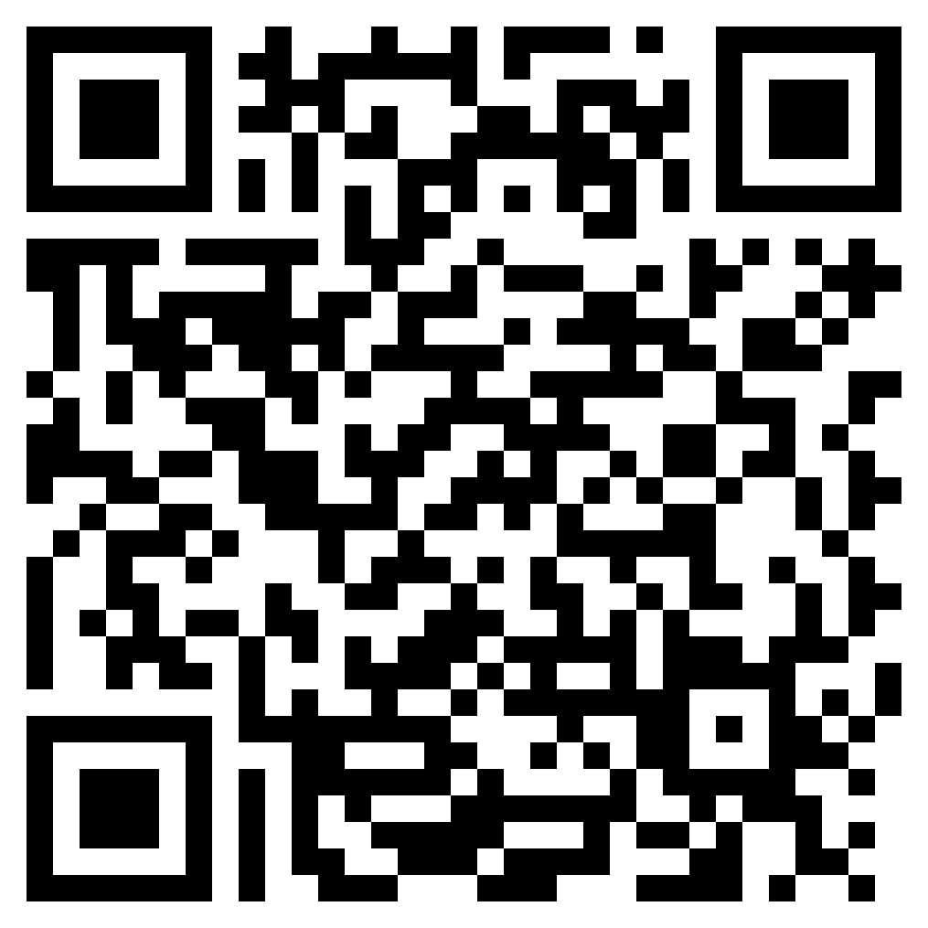
Scan this QR Code for a reference list for this document and additional resources.
Notes:
All references that went into creating this presentation and the accompanying flyer can be found with this QR code alongside additional resources for hosting safe events that serve alcohol.

Slide 10
Thank you!
This PowerPoint was made possible by grants GA133532 and GA133529 from the Health Resources and Services Administration (HRSA), an operating division of the U.S. Department of Health and Human Services. Its contents are solely the responsibility of the COP-RCORP Consortium members and do not necessarily represent the official views of HRSA or the U.S. Department of Health and Human Services.

