Slide 1



“Paws Off Those Meds”
Partnering with your Local Veterinary Community to Reduce Diversion
Bill Gibson, Executive Director, Power of Putnam
-
Dr. Meggan Graves, Clinical Associate Professor,
University of Tennessee College of Veterinary Medicine– Knoxville
-
Is a registered trademark and is used under license to the grantee
This project is funded under a grant contract with the Tennessee Opioid Abatement Council.

Slide 2
Introduction
Enhance understanding of the problem of diversion of medications prescribed for animals, to human use
Provide an overview of a collaborative diversion prevention project that went from community level to national-level in 3 years
Discuss strategies to implement a local diversion prevention in your community

Slide 3
Current Understanding
Have you had an animal prescribed a controlled substance by a veterinarian?
Have you heard of someone seeking to access controlled substances for personal use by utilizing an animal?
Is this kind of diversion a problem in your community?
Are there any ongoing local efforts to address it?

Slide 4

Scenario to Consider
8 veterinary clinics
You struggle with opioid addiction
Dispense and store controlled drugs
2 clinics offer mobile services
Prescriptions are more difficult to obtain
Drugs on the street are hard to get and expensive
You are planning ways to gain access to drugs…
What are 5 things you might try?

Slide 5
Problem Overview
Drug diversion is a kind of drug misuse involving the unlawful deviation of medicines from legal distribution and dispensing channels to an illicit marketplace (Anand & Hosanagar, 2021).
Vet shopping is the solicitation of veterinarians to obtain a controlled substance prescription for their animal with no intent of administering to their animal (Patel et al, 2020).

Slide 6
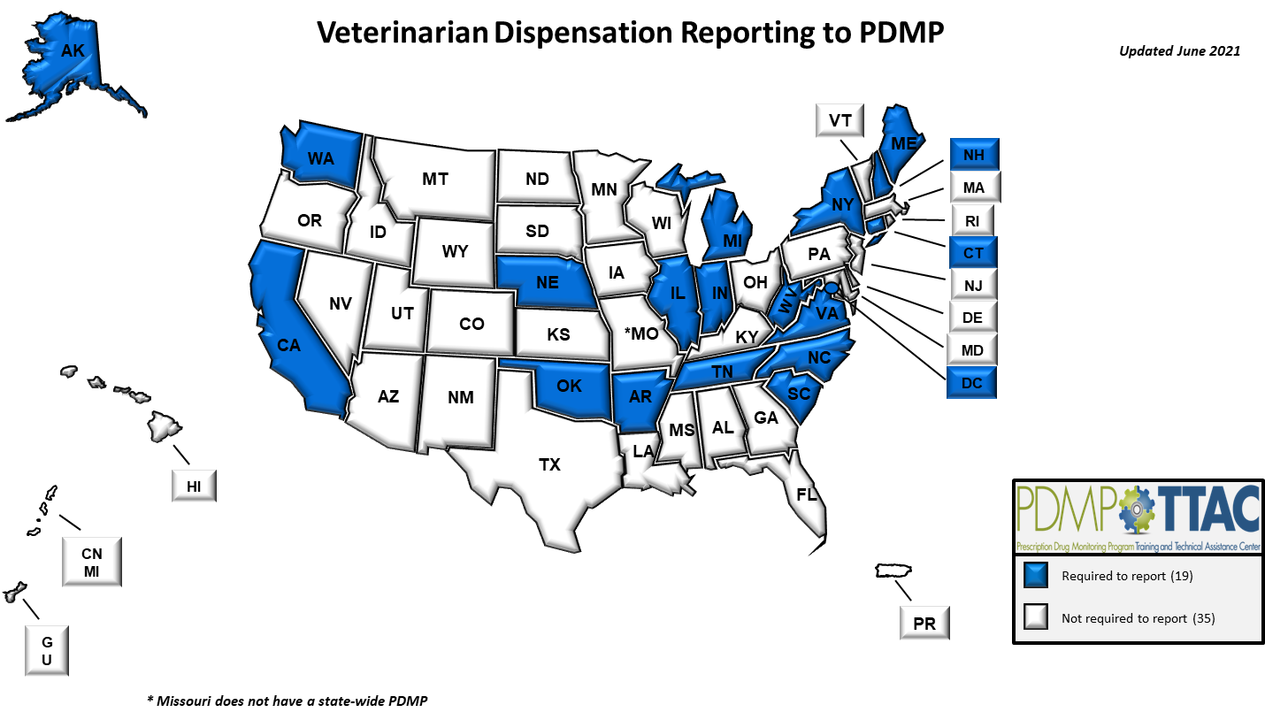

Slide 7
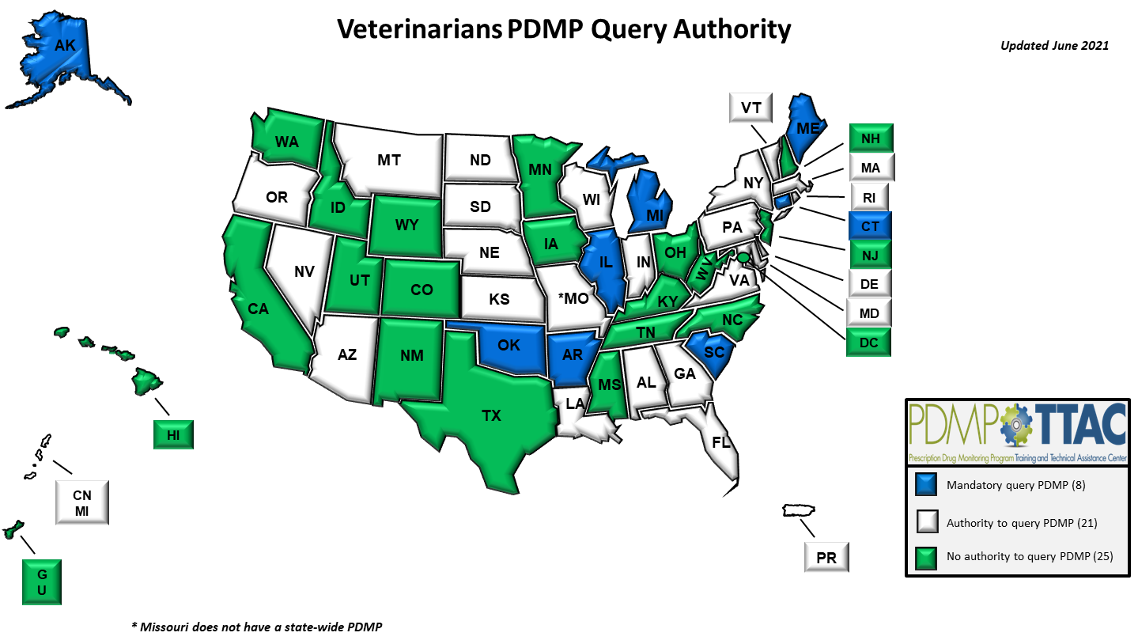

Slide 8
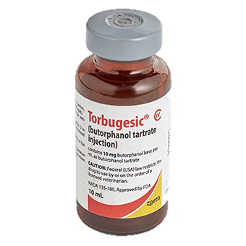
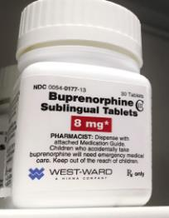
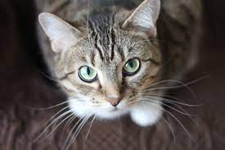
Why Do People “Shop” at Veterinary Clinics?
Are the drugs for animals the same as human drugs ?
YES!

Slide 9
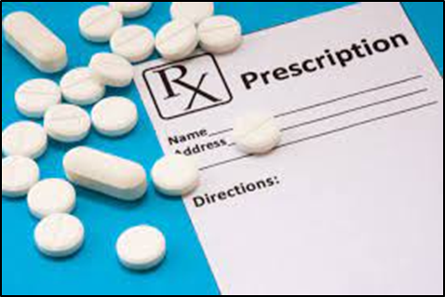

Animal Medicinal Drug Use Clarification Act (AMDUCA)
To use a drug “on-label” requires that the drug be used in the species for which it is approved, for the indication, by the route, at the dose and for the duration indicated in the labeling
For all extra-label drug use, there must be a valid veterinary-client-patient relationship

Slide 10
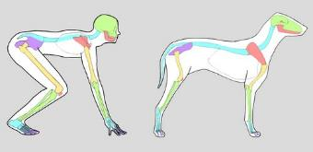





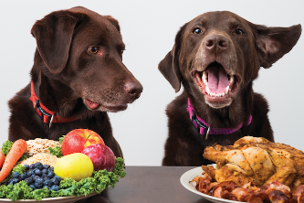


Differences in Pets and Humans
Photo credit: Kyle Hall
Gerrard Gethings
Dogster.com

Slide 11
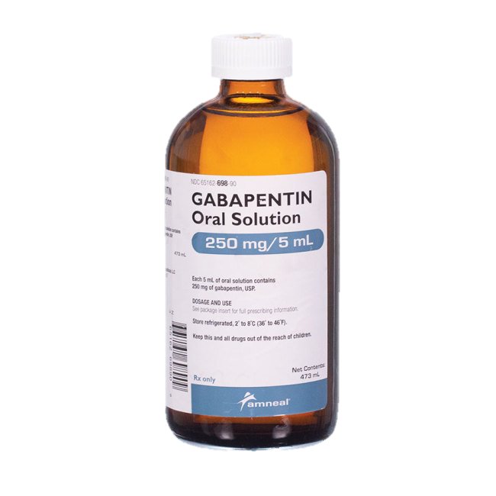
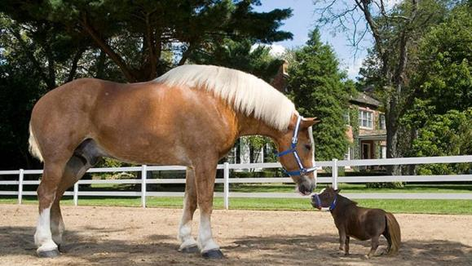
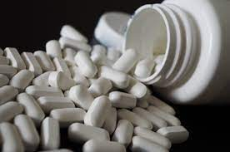
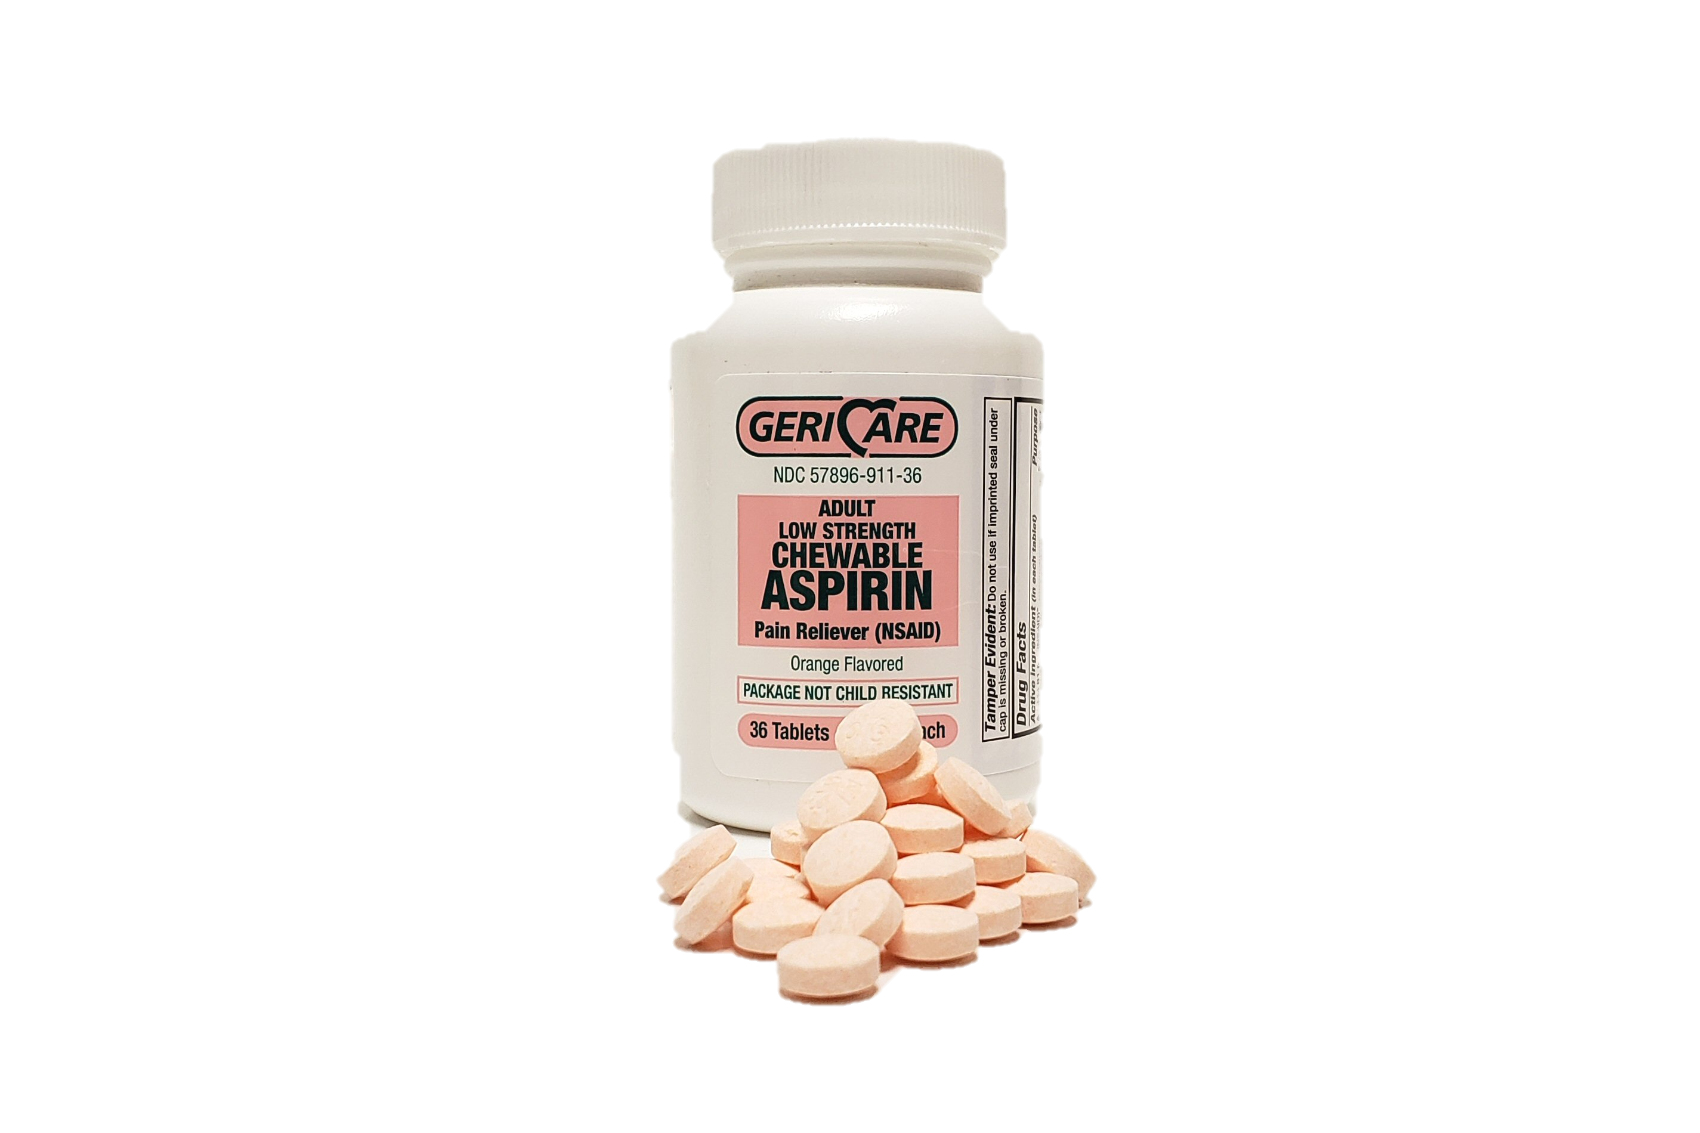
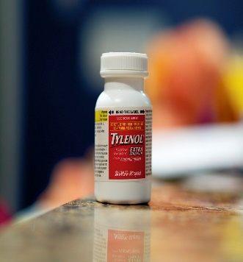
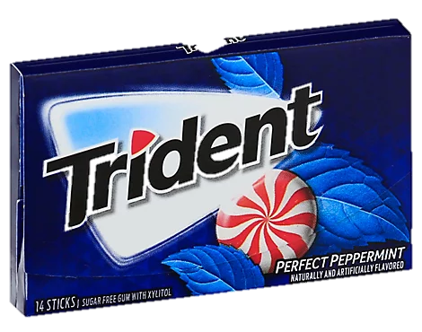
Differences cause variations
Absorption
Distribution
Metabolism
Bioavailability
Elimination

Slide 12
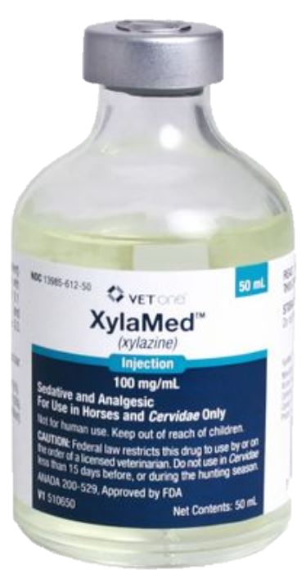
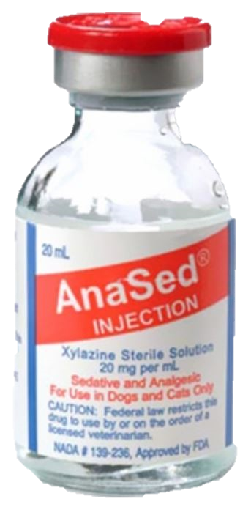

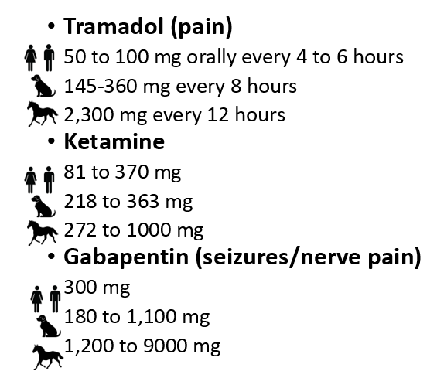
Examples
Combining multiple drugs is even MORE dangerous!
XYLAZINE:
Sedative
“tranq dope”

Slide 13
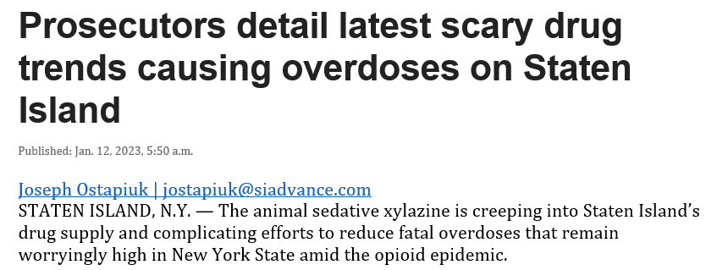
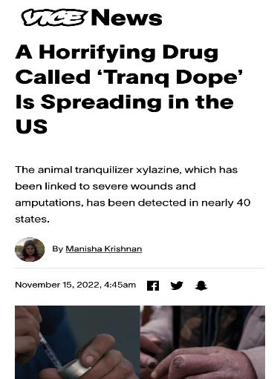
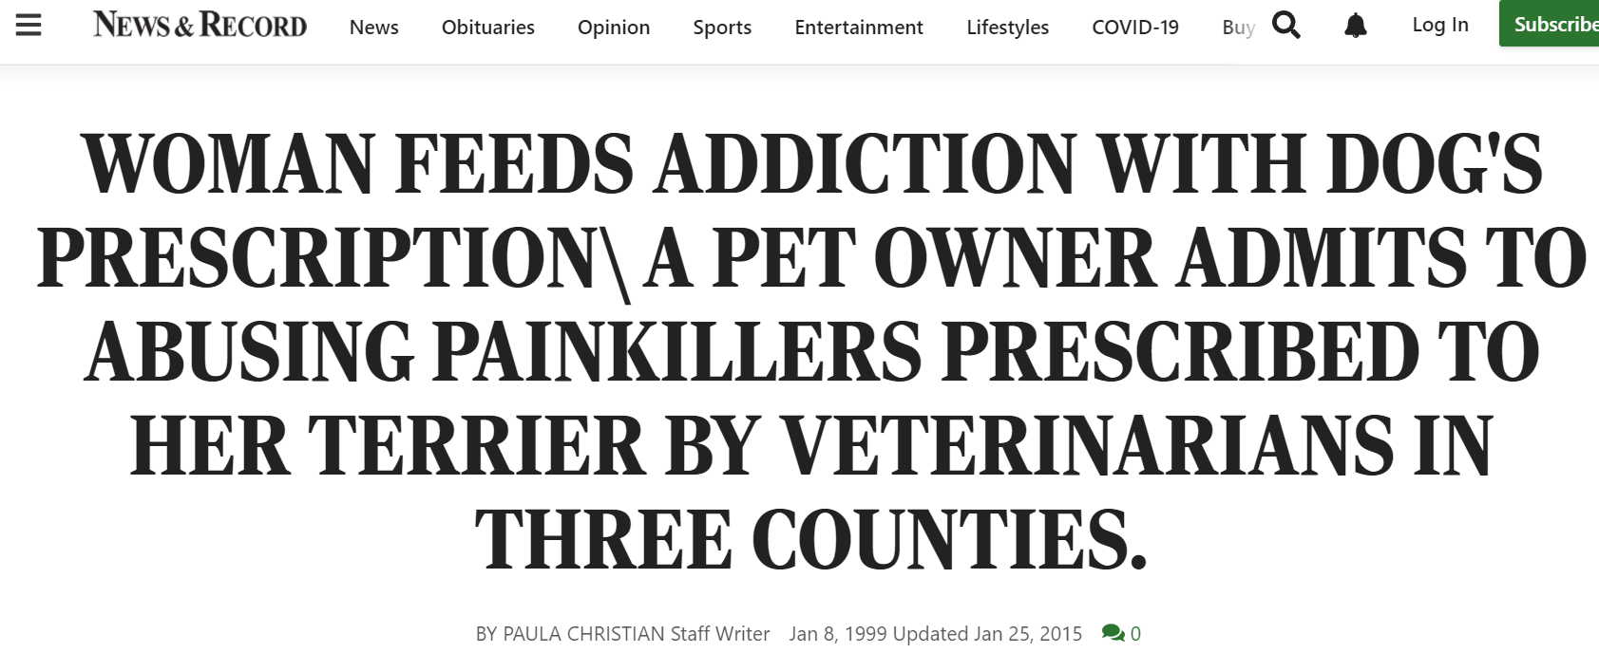
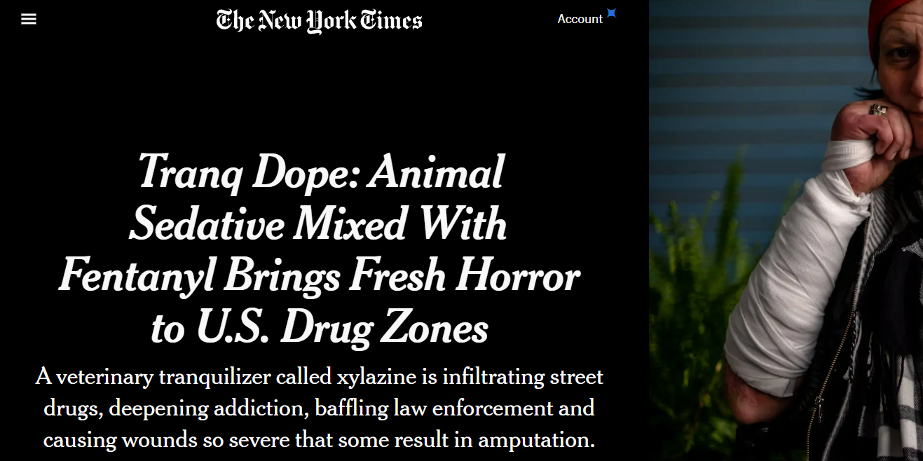
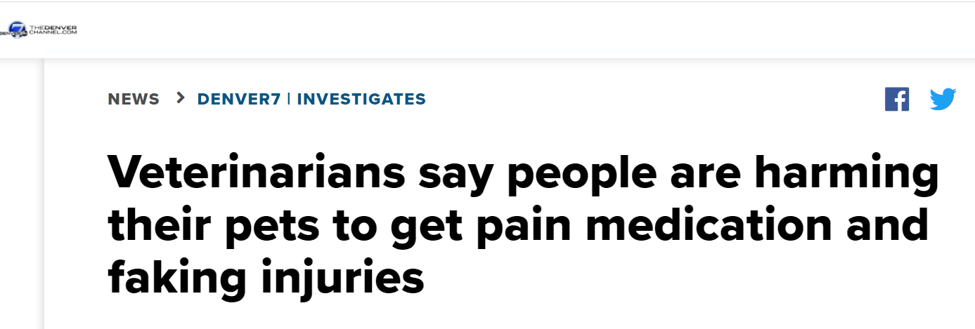
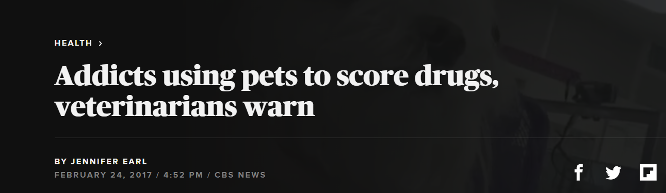
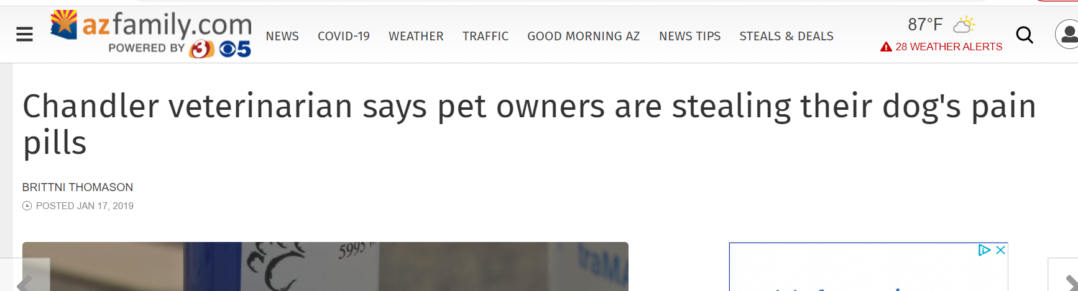
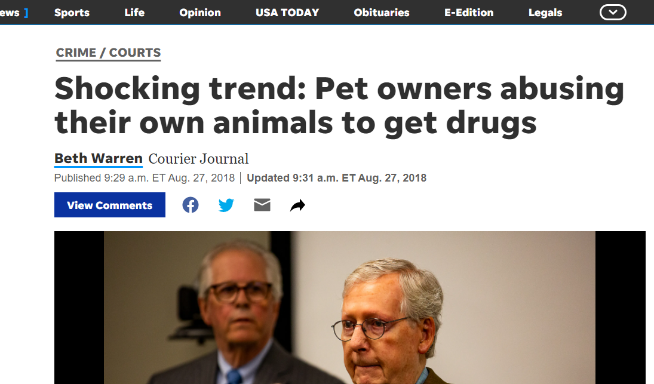
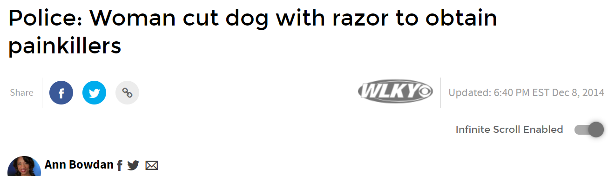
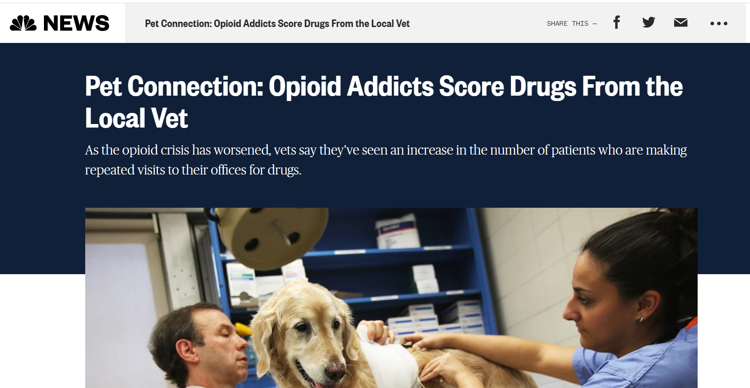
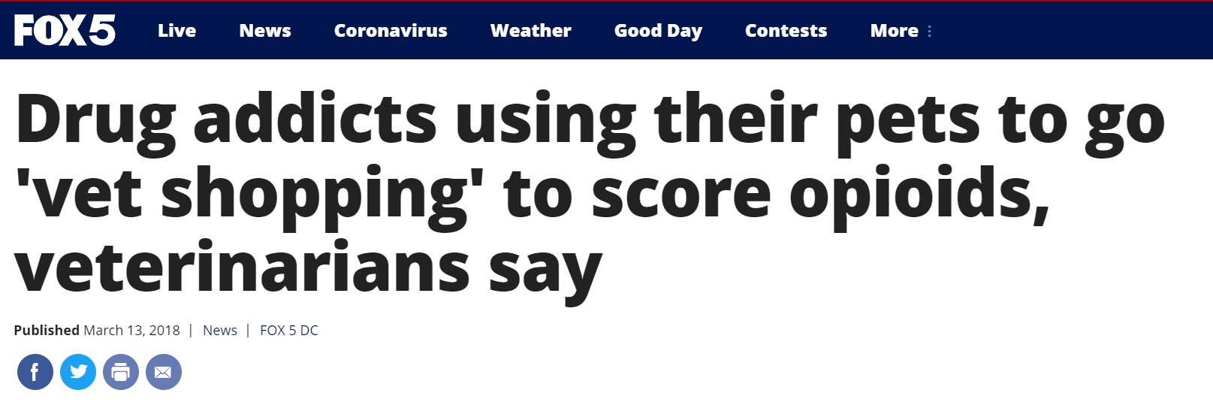
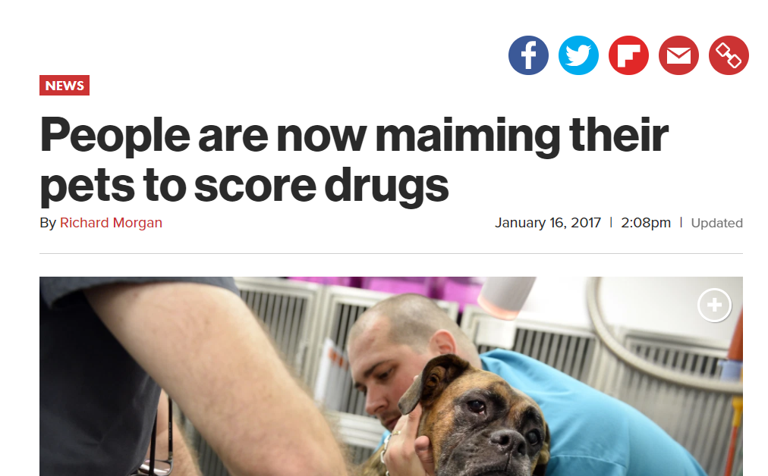
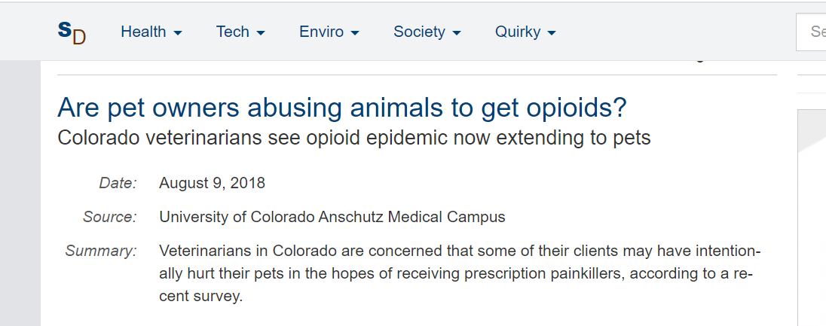
Anecdotal Evidence
Numerous news reports provide evidence of isolated cases of pet-shopping or intentional injuries to animals in order to acquire prescription medications

Slide 14
What We Know from Scientific Research…
Misuse & Concerns about Misuse:
  Prescribing trends suggest a potential for diversion
  DEA ARCOS data suggests a lack of decline in opioid prescriptions among veterinary medicine during a time in which human medicine saw a sharp decrease in opioid prescriptions.
  Survey data indicates that:
    (a) many veterinarians have observed or are aware of cases of prescription drug diversion in their practices
    (b) many veterinarians are concerned about prescription drug diversion in their practices

Slide 15
What We Know from Scientific Research…
Need for Education:
  Survey data from veterinarians suggest that
    many veterinarians feel they do not have the proper training in prescription drug misuse
    many veterinarians desire more education in prescription drug misuse

Slide 16
What We Know from Scientific Research…
Need for Communication:
  Veterinarians expressed a need or desire for a database to track animal prescriptions
  No governmental body tracks crossover use of veterinary medicine

Slide 17

Assessment Data
61 respondents
Majority >10 years experience
Great variation in the size of the practice
Predominantly small animal practices
Rural/Suburban/Urban
Most worked 4 (25) to 5 (18) days/week
~70% treat emergencies

Slide 18
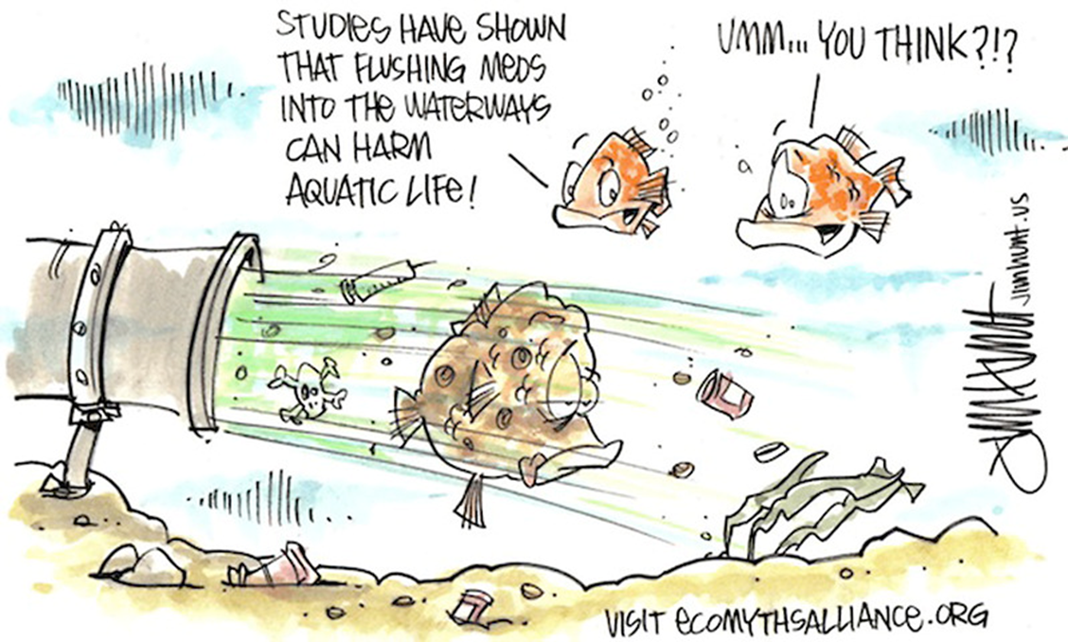
Assessment Data
88% dispense controlled substances to clients
>10% dispense 70+ controlled substance prescriptions/week
>90% do NOT offer disposal

Slide 19

Assessment Data
Over 90% had heard of “vet shopping”
~75% have experienced vet shopping in the past 3 years
~25% injured animal for pain medication
36% felt vet shopping was a problem in their community
52% feel it is a problem in their region of the country
~70% feel it is a problem nationwide

Slide 20
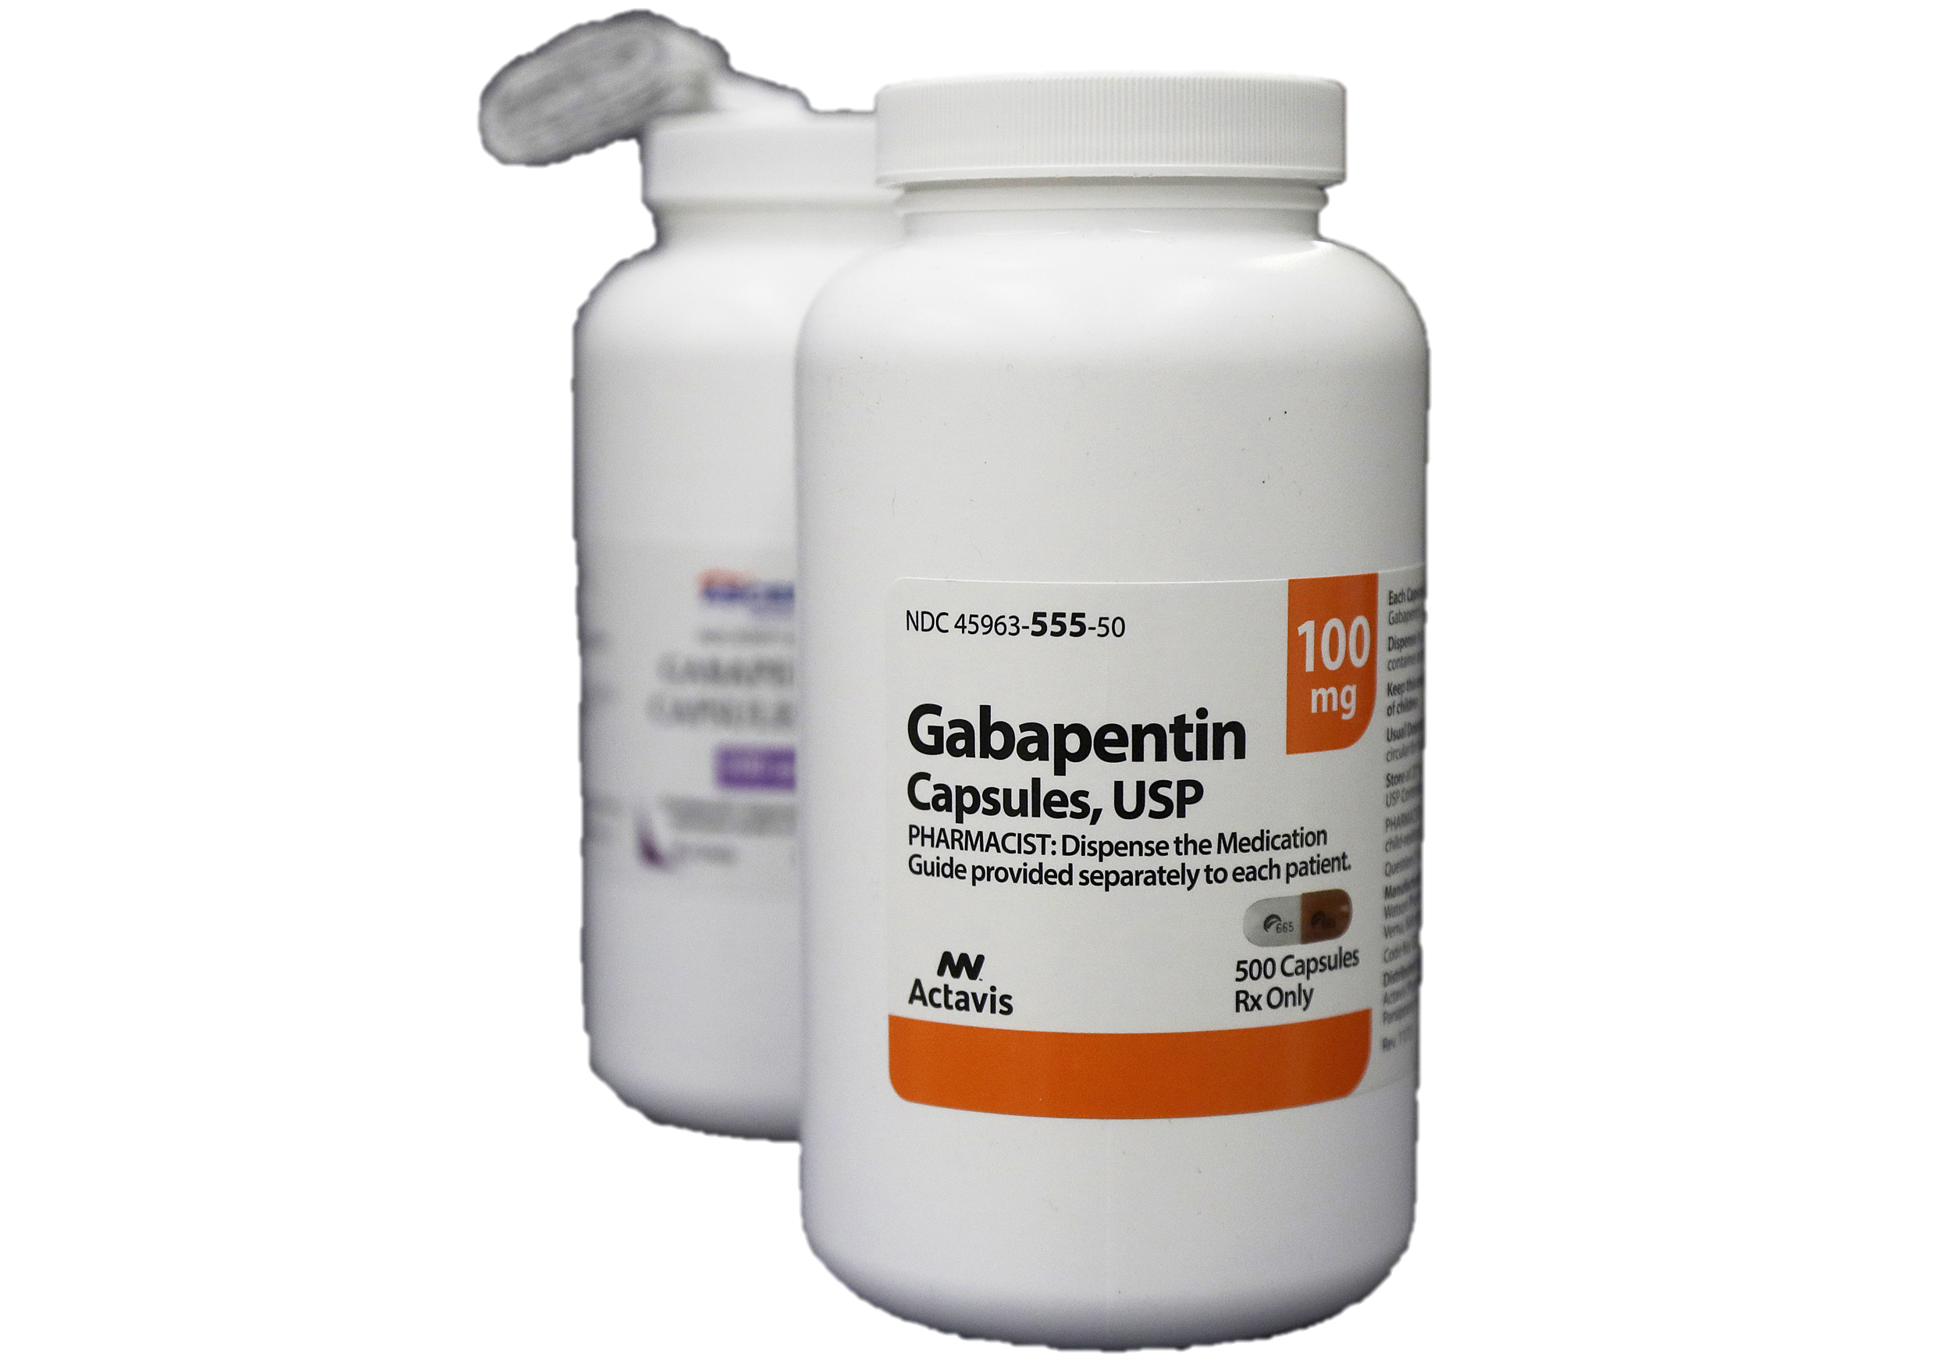
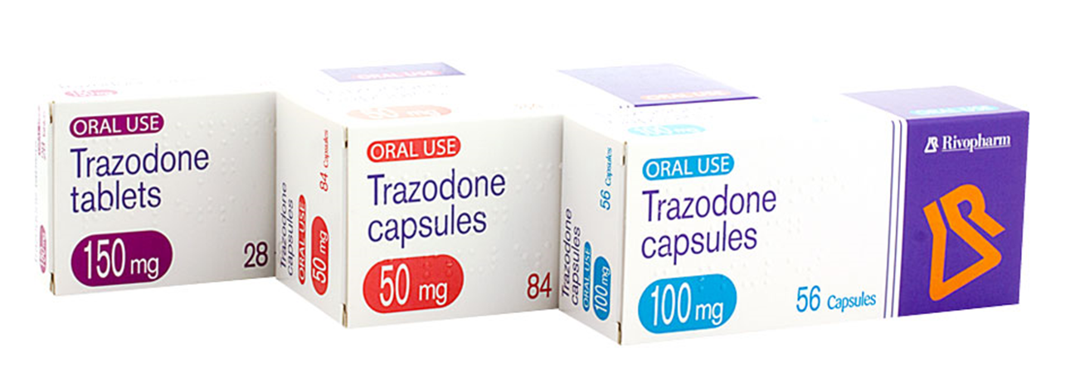
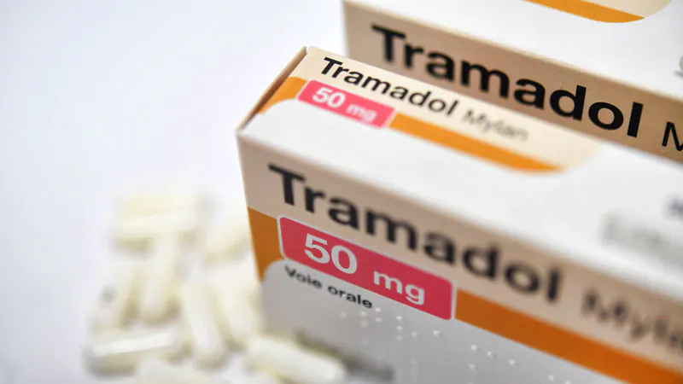
Assessment Data
Most common classes of drugs reported to be prescribed in our assessment were:
Serotonin modulators and Gabapentin

Slide 21

Assessment Data: Prevention
46% have NEVER received training on prevention and/or management of vet shopping
>75% - clients ask questions about use of animal medications in humans
59% do NOT talk about potential abuse of veterinary medications with clients
~85% do NOT provide printed material (fliers/brochures) about potential abuse
of veterinary medications

Slide 22
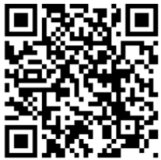
Veterinary Continuing Education Course
American Association of Veterinary State Boards Registry of Approved Continuing Education (RACE) program (2 hours)
  Six Modules:
    Introduction & Overview of Abuse & Misuse of Controlled Substances of Prescribed to Animals
    Research on Prescription Diversion in Veterinary Medicine
    Overview of Prescription Reporting Requirements for Veterinarians & Ethical Challenges
    Understanding Drug Abuse & Addiction
    Introduction to the use & Application of Naloxone for Overdose Reversal
    Substance Misuse in the Veterinary Setting
    Conclusion
  https://www.tntech.edu/cahe/hec/caps/vetce-csd.php

Slide 23
Connecting Local Prevention Efforts
The free online course is approved for continuing education for veterinarians, veterinary nurses and veterinary technicians in all 50 states.
The course is a centerpiece for local outreach to educate and update the veterinary profession about the diversion problem and best practices to prevent it.
Any interested community can develop and provide locally branded resources to form partnerships with your animal care community.

Slide 25

Resources
Along with continuing education, your community can offer support to help deal with this problem when they encounter it.
This includes:
Overdose reversal training and kits
Free home medication lockboxes for patient owners
Informational brochures
Signage for waiting and treatment rooms
Sample controlled substance office policy and patient agreements
Medication container and bag warning stickers

Slide 26
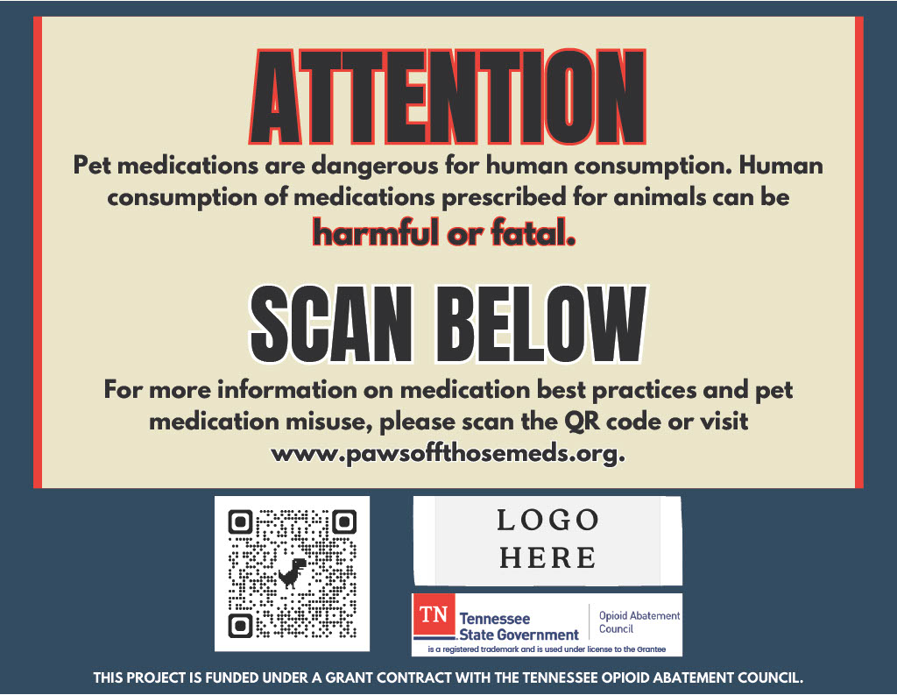

Slide 27
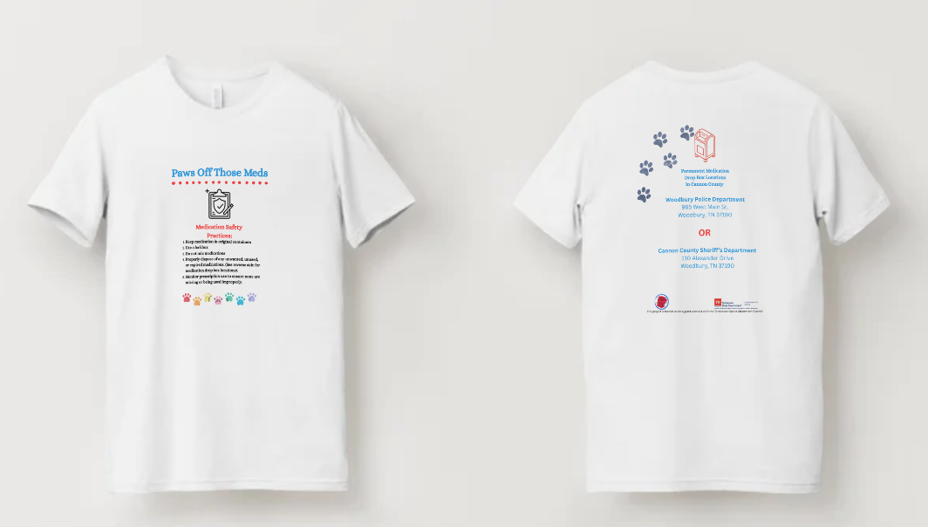
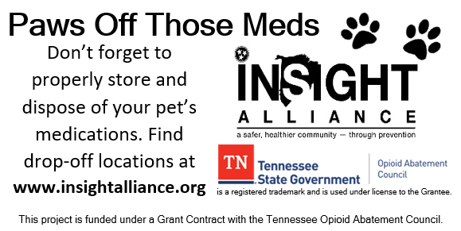
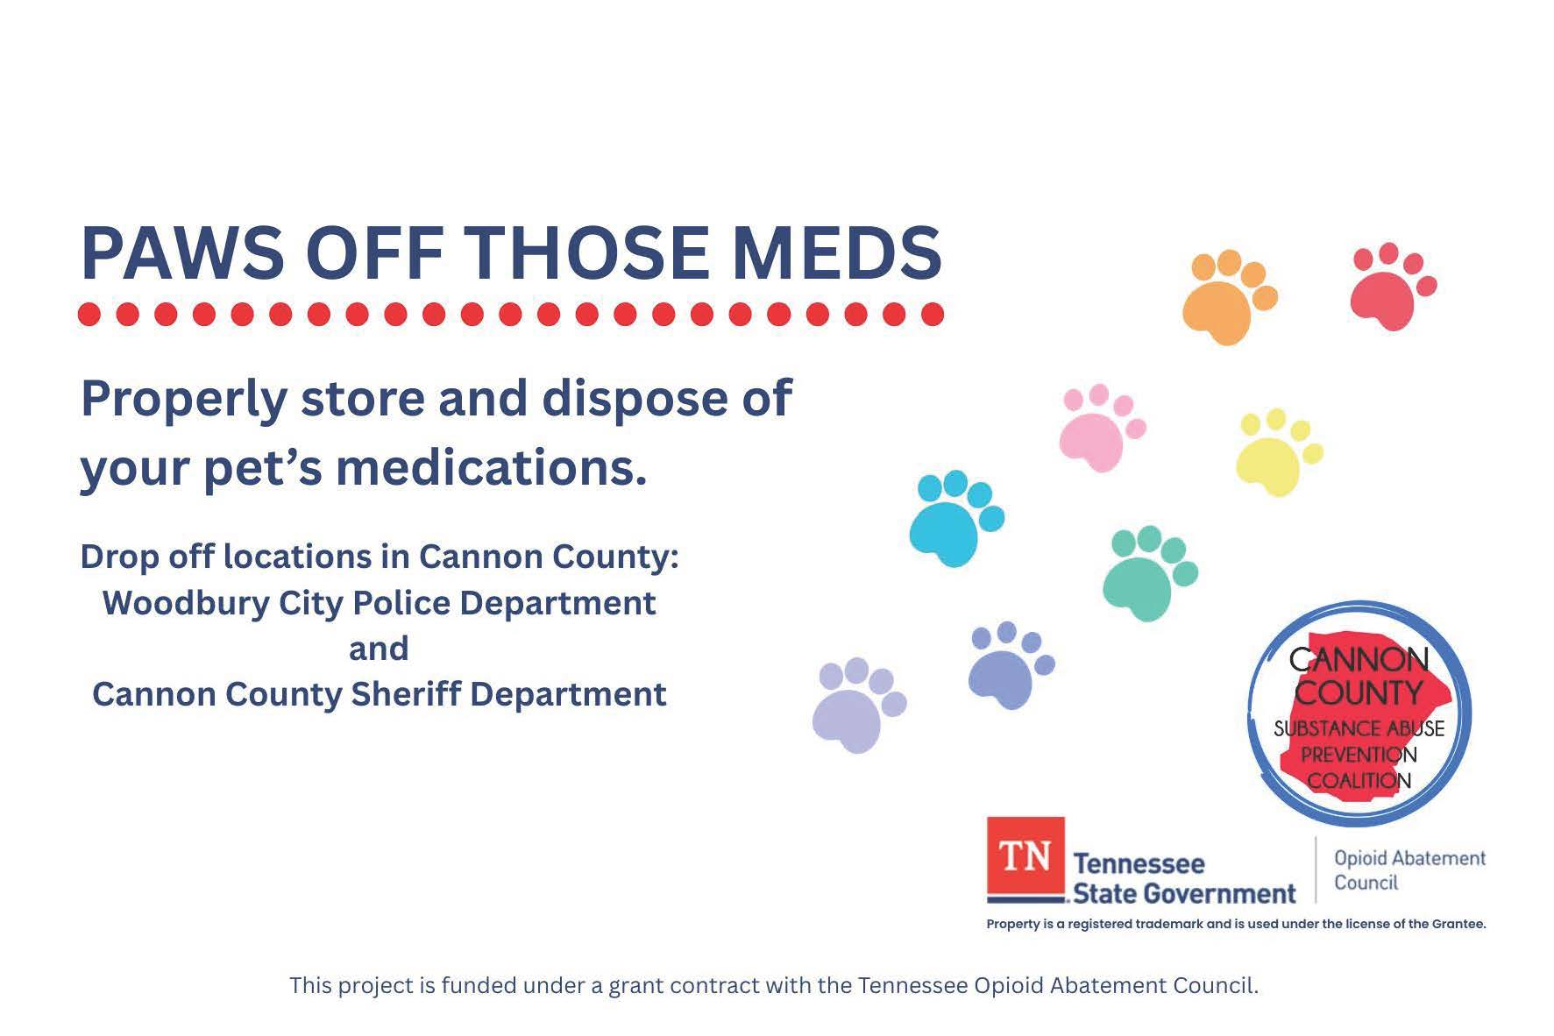

Slide 28
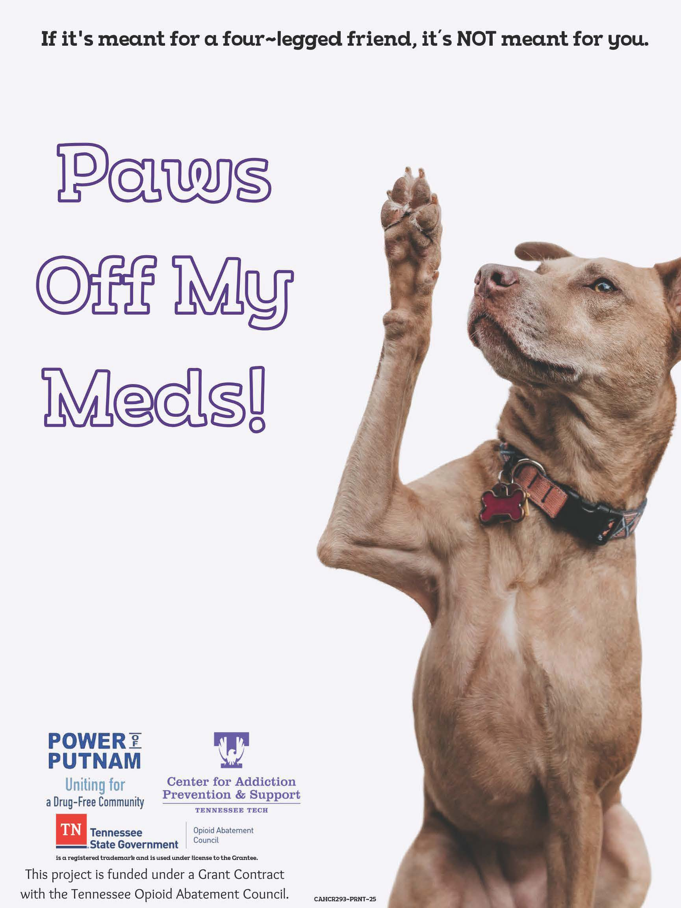
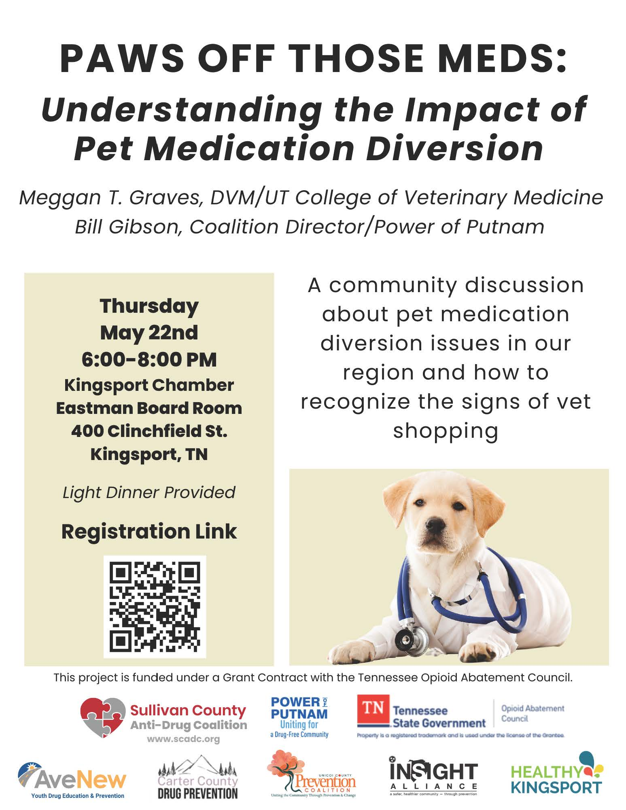

Slide 29
Connecting to the Strategies:
CADCA’s 7 Strategies for Community Change
1. Providing Information: To Veterinary Clinics and the public.
2. Enhancing Skills: Specific training and technical for all office staff in identification of drug seeking behaviors
3. Providing Support for Prevention Activities: Sticker and information campaign at local veterinary practices
4. Enhancing Access/Reducing Barriers: Part of the project includes referral to recovery services

Slide 30
Connecting to the Strategies:
CADCA’s 7 Strategies for Community Change
5. Changing Consequences: Increasing the likelihood that Vet shoppers will be identified and charged thereby reducing access. Recognizing practices that partner in this effort.
6. Changing Physical Design/Making Environmental Changes: Office waiting and treatment room signage / External signage – No Controlled Substances on Premises
7. Modifying/Changing/Developing Policies: Developing office policy, adopting best practices & patient controlled substance agreements

Slide 31
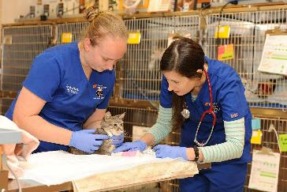
Reducing Diversion
What ideas do you have on effective ways to prevent diversion in veterinary medicine?

Slide 32



Thank You
Bill Gibson, Executive Director, Power of Putnam
bill@powerofputnam.org
Dr. Meggan Graves, Clinical Associate Professor,
University of Tennessee College of Veterinary Medicine– Knoxville
mtoohey@utk.edu
Is a registered trademark and is used under license to the grantee
This project is funded under a grant contract with the Tennessee Opioid Abatement Council.

